Slide 1
DEPARTMENT OF COMPUTER SCIENCE & APPLICATIONS
OPEN COURSE SYLLABUS

Slide 2
BCA5D01
Introduction to Computers and Office Automation

Slide 3
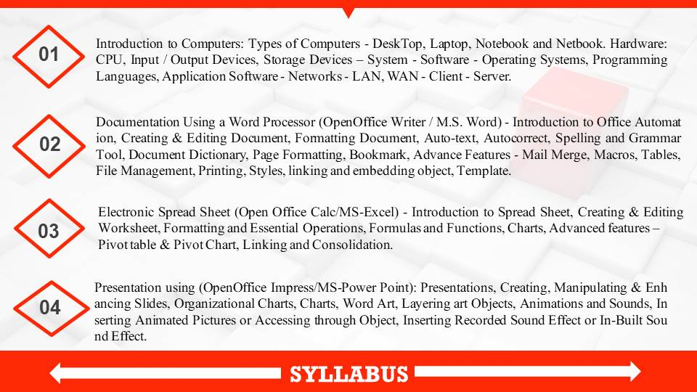

Slide 4
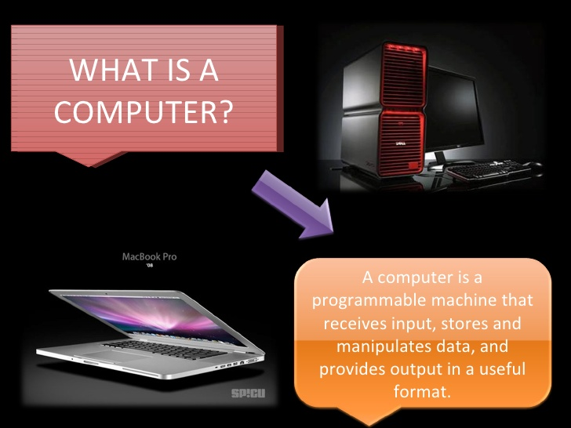

Slide 5
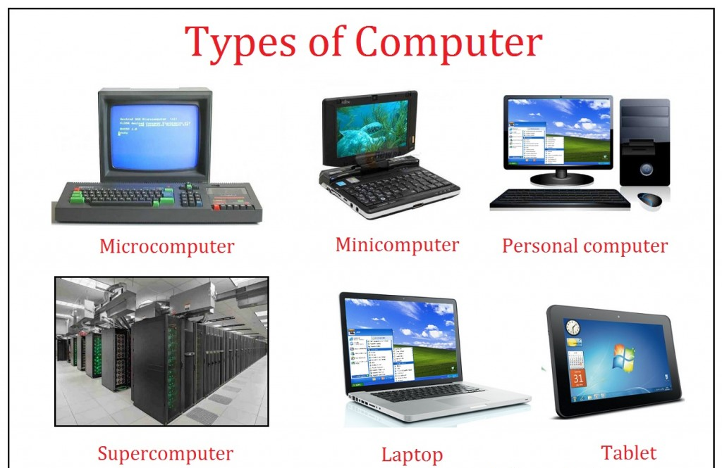

Slide 6
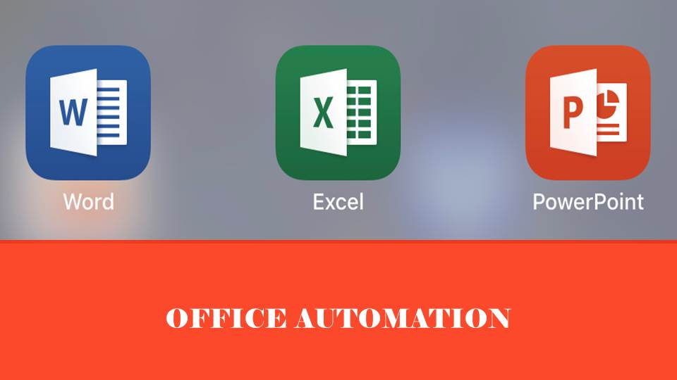

Slide 7
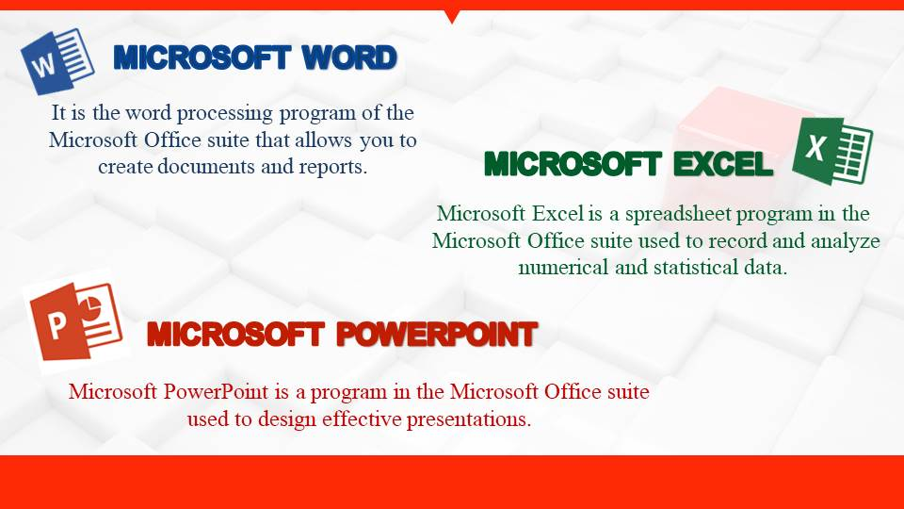

Slide 8


